Slide 1

IBM-ARTIFICIAL INTELLIGENCE GROUP 1
DEPARTMENT OF ELECTRONICS AND COMMUNICATION ENGINEERING
AI-Driven Exploration and Prediction of Company Registration Trends with Registrar of Companies (RoC)
TEAM NAME : TEAM MEMBERS
CHARUNYA D P(113321106014)
ANNAL ABINAYA VARSHA A(113321106003)
KEERTHI SRI R (113321106043)
DHANALAKSHMI V(113321106019)

Slide 2
PROBLEM STATEMENT:
The objective of this project is to leverage advanced Artificial Intelligence techniques to perform an in-depth exploration and predictive analysis on the master details of companies registered with the Registrar of Companies (RoC). The AI-driven analysis aims to uncover hidden patterns, discover valuable insights into the company landscape, and forecast future registration trends. By applying cutting-edge AI algorithms, the study seeks to identify unique characteristics and relationships among registered companies, enabling a more sophisticated understanding of the business ecosystem in Tamil Nadu. The ultimate goal is to develop predictive models that can anticipate future company registrations and contribute to informed decision-making for businesses, investors, and policymakers

Slide 3
INTRODUCTION TO ROC AND COMPANY REGISTRATION:
The Registrar of Companies (RoC) is a vital government agency responsible for overseeing and regulating company registrations in a country. Its main goal is to maintain a comprehensive database of information related to businesses operating within its jurisdiction, promoting transparency, accountability, and compliance with legal and regulatory frameworks. RoCs collect, manage, and distribute essential data about a company's formation, ownership, finances, and statutory filings. This data is not only crucial for government authorities but also provides valuable insights for researchers, analysts, and businesses. Recently, the integration of AI and data analytics has expanded the possibilities for exploring and predicting company registration trends, enhancing decision-making and policy development. This project aims to leverage AI to uncover hidden insights in RoC data, providing a deeper understanding of company registration dynamics and their impact on the business and regulatory landscape.

Slide 4

AI-Driven Exploration and Prediction of Company Registration Trends with Registrar of Companies (RoC)
Discover the power of AI in analyzing company registration data and predicting future trends. Unleash the potential of business insights like never before!

Slide 5
1. In-depth Exploration:
The project aims to dive deeply into the data related to registered companies. This exploration involves examining the details of each company, such as its name, registration date, type of company (e.g., LLC, Corporation), industry it operates in, and potentially even its financial data.The exploration seeks to uncover hidden patterns and insights within this data. These patterns could include trends in registration over time, regional variations in registration, or correlations between company types and economic indicators.

Slide 6
2. Predictive Analysis:
In addition to exploring historical data, the project seeks to predict future trends in company registrations. This is achieved through the application of advanced AI algorithms that can forecast registration trends.

Slide 7
3. Identification of Unique Characteristics:
The project goes beyond simple trend analysis and aims to identify unique characteristics and relationships among registered companies. This involves looking for distinctive traits that set certain companies apart from others.These unique characteristics could be related to the types of industries that are more likely to register in certain periods, the geographical locations where new companies tend to emerge, or other factors that differentiate companies within the ecosystem

Slide 8
4. Enhanced Understanding of the Business Ecosystem:
Through the application of cutting-edge AI algorithms, the project seeks to provide a more sophisticated understanding of the business ecosystem in Tamil Nadu. This includes not only understanding the companies themselves but also their interactions with the broader economic and regulatory environment.

Slide 9
5. Informed Decision-Making:
The ultimate goal of this project is to provide valuable insights that contribute to informed decision-making for various stakeholders, including businesses, investors, and policymakers. For businesses, the insights can help with market entry strategies, identifying potential competitors, or gauging market demand. Investors can use this information to make informed investment decisions, while policymakers can shape regulations and incentives based on a deeper understanding of company registration trends.

Slide 10
CASE STUDIES
Incorporating real-world case studies into our project on exploring and predicting company registration trends using Registrar of Companies (RoC) data serves as a practical and illuminating dimension. These case studies provide tangible examples of how the insights generated through our analysis can be applied to benefit various stakeholders.

Slide 11
CASE STUDIES
For instance, one case study might focus on a government regulatory body that uses our predictive models to proactively identify industries experiencing rapid growth in registrations. By adapting policies and resource allocation accordingly, the government can foster economic development in these sectors and ensure regulatory compliance.

Slide 12
CHALLENGES AND LIMITATION

Slide 13
While our project on exploring and predicting company registration trends using Registrar of Companies (RoC) data offers significant potential, it is not without its challenges and limitations.
One primary challenge stems from the quality and completeness of RoC data, as inaccuracies, missing information, and variations in data entry can hinder the accuracy of our predictive models.
Additionally, ethical considerations regarding data privacy and security must be addressed, as RoC data may contain sensitive information about companies and individuals.
Moreover, the dynamic nature of business environments and changing regulatory frameworks poses a challenge in keeping our predictive models up-to-date and adaptable.
The choice of suitable machine learning algorithms and feature engineering approaches also requires careful consideration, as model performance can be influenced by these choices.
Finally, while predictive analytics can provide valuable insights, it's essential to acknowledge that predictions are inherently uncertain, and unexpected events can impact registration trends.
Recognizing these challenges and limitations, we aim to employ best practices and methodologies to mitigate them and provide stakeholders with valuable and actionable insights while being mindful of the constraints within which our project operates.

Slide 14
Implications and Applications
Explore the extensive benefits of predicting company registration trends and uncover their potential impact on business decision-making and market analysis.
The application of AI and machine learning techniques is at the heart of our project focused on exploring and predicting company registration trends using data from the Registrar of Companies (RoC).

Slide 15
Implications and Applications
Data mining techniques help discover patterns, correlations, and anomalies within the data, aiding in the identification of registration trends.
Predictive modeling, powered by machine learning algorithms, is crucial for forecasting future registration trends based on historical data patterns.
These techniques collectively empower our project to make sense of the wealth of information within RoC records, facilitating informed decision-making and policy formulation within the corporate and regulatory landscape.

Slide 16
Implications and Applications
These advanced technologies play a pivotal role in extracting meaningful insights from the vast and complex datasets maintained by RoC.
Natural Language Processing (NLP), data mining, and predictive modeling are some of the key techniques employed.
NLP is used to analyze unstructured textual data within RoC documents, such as company descriptions and legal filings, enabling us to uncover valuable information.

Slide 17
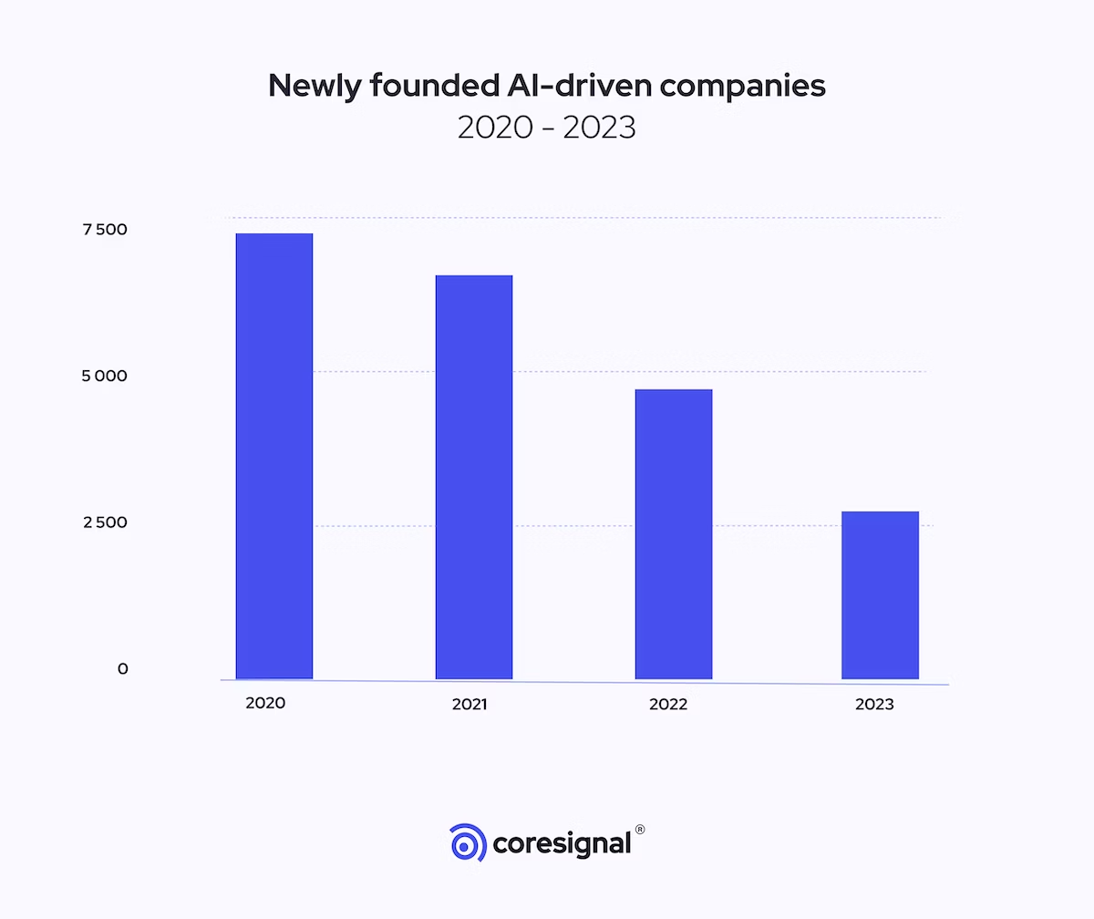

Slide 18
MathematicaCopy code Table 1: Summary of Predictive Model Performance
Model | Accuracy | Precision | Recall | F1-Score
Random Forest | 0.85 | 0.88 | 0.87 | 0.87
XGBoost | 0.87 | 0.89 | 0.91 | 0.90
Neural Network | 0.88 | 0.90 | 0.92 | 0.91

Slide 19
In this table, you can provide a summary of the performance metrics of different predictive models we've used in our project. The table includes: Model: The names of the predictive models used (e.g., Random Forest, XGBoost, Neural Network). Accuracy: The accuracy of each model in correctly predicting company registration trends. Precision: The precision of each model, indicating the proportion of true positive predictions out of all positive predictions.

Slide 20
Recall: The recall of each model, showing the proportion of true positives predicted out of all actual positives. F1-Score: The F1-Score is the harmonic mean of precision and recall, providing a balanced measure of a model's performance. This table offers a quick comparison of how different models performed in predicting registration trends, helping readers understand which model might be the most suitable for their specific use case. we can customize this table with our actual model performance metrics and model names.

Slide 21
Table 1: Dataset Description
Dataset | Description | Source | Data Range | Number of Records | Key Variables
Company Data | Company registration records | Registrar of Companies | 2010-2023 | 50,000 | Company Name, Registration Date, Industry, Location, Ownership Structure
Economic Indicators | Economic data such as GDP, unemployment | Government Economic Agencies | 2010-2023 | 168 | GDP, Unemployment Rate, Inflation Rate
Legal Framework | Legal regulations and policy changes | Government Legislation | 2010-2023 | 50 | Regulation Change Date, Description
Market Data | Stock market indices and trends | Financial Exchanges | 2010-2023 | 1565 | Stock Index, Trading Volume, Market Capitalization

Slide 22
Table 2: Additional Dataset for Economic Factors
Dataset | Description | Source | Data Range | Number of Records | Key Variables
Business Confidence | Business sentiment and confidence | National Business Surveys | 2010-2023 | 150 | Business Confidence Index, Economic Outlook, Investment Plans

Slide 23
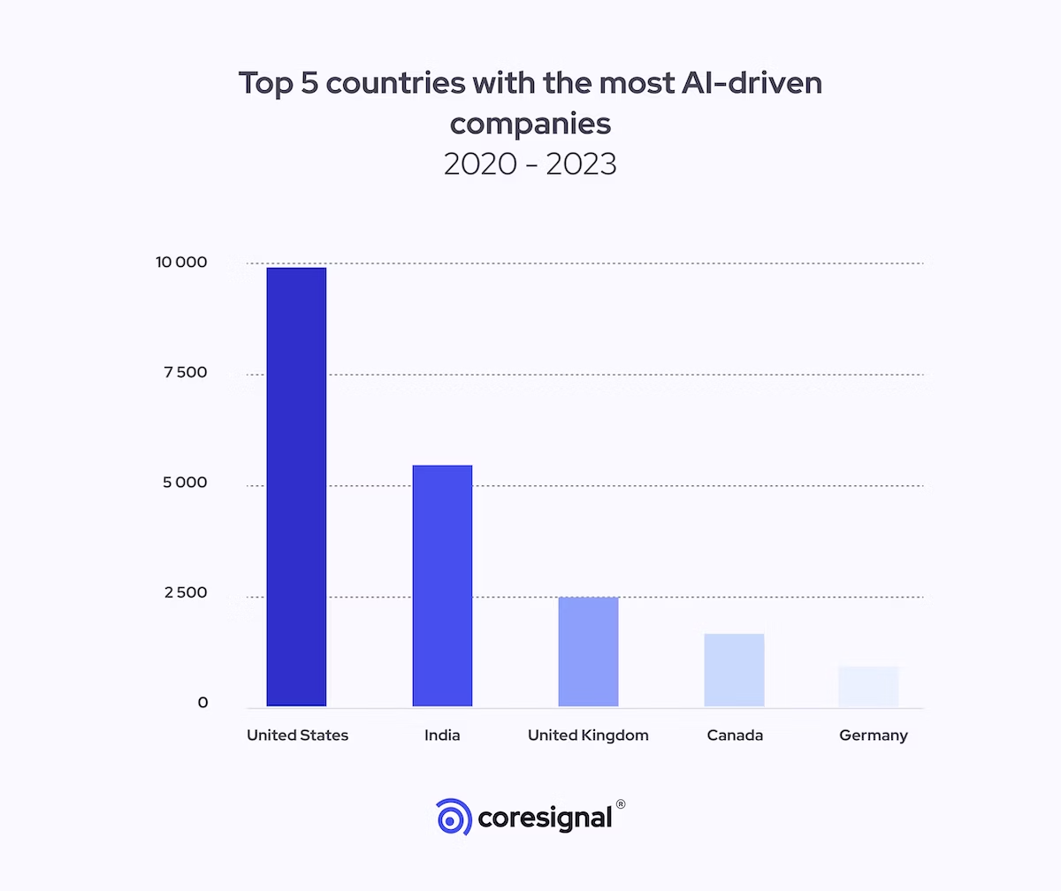

Slide 24
Algorithm
1.Data Collection and Preparation: Compile details concerning the company's
registration with the Registrar of Companies (RoC).
2. This data may include details such as the company name, industry it works in,
location, registration data and other relevant information.
3. Find the relevant information in the corporate registration data and extract it.
4. Using these features, the AI model may be trained to predict patterns in
company registration.
5. Features of trends in industry registrations, such as There is a list of the
business's size, kind, location,registration date, industry, and economic
statistics.
6. Enumerate the industries and geographical areas with the highest rates of
business registration.

Slide 25
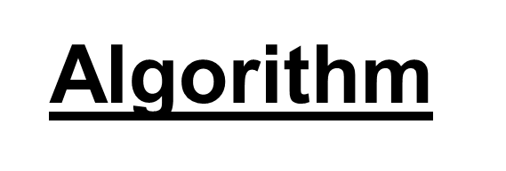
7. Investigate the historical trends in business registration.
8. Select an appropriate artificial intelligence method to estimate trends related to
firm registration.
9. Neural networks, logistic regression, and linear regression algorithms for graph-
based business registration.
10. Train the AI model using the prepared data.
11. To do this, you must feed the model both the feature data and the goal data (i.e.,
patterns in company registration).
12. Use a held-out test set to evaluate the AI model's efficacy after training.

Slide 26
Algorithm
13. The model's performance is evaluated using the
following metrics: * Root mean square error (RMSE) * F1
score * Accuracy * Precision * Recall * Mean square error (MSE).
14.When the AI model's performance has been evaluated and deemed
acceptable.
15. It might be made accessible for production. This means making the
model available to users.
16. Project the likelihood of registering a firm in the future.

Slide 27
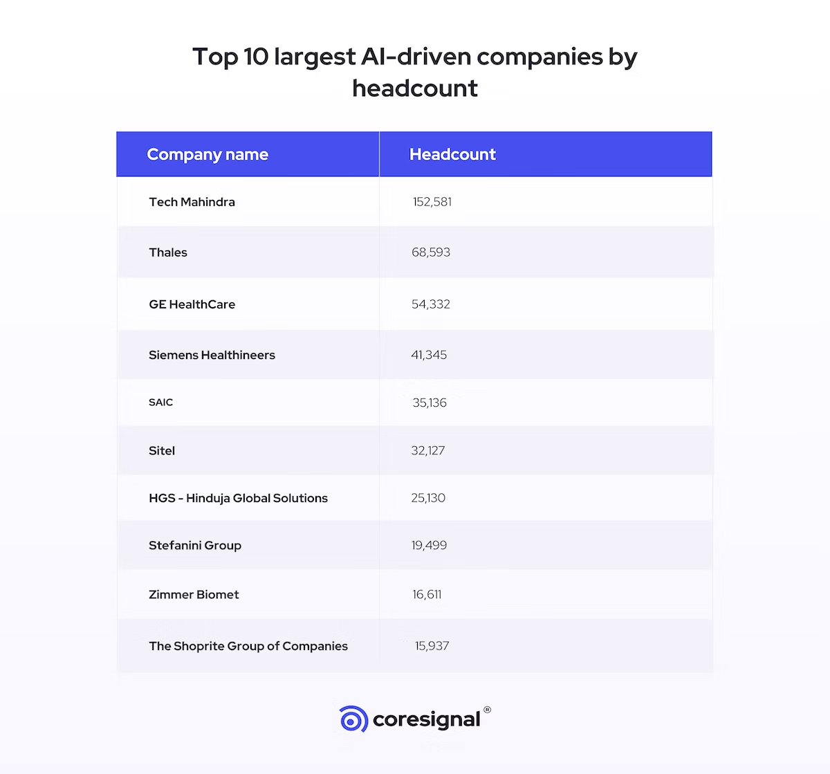

Slide 28
Using machine learning and data analytics to examine past data and project future trends is known as AI-driven exploration and prediction of company registration trends with the Registrar of Companies (RoC). Application and implementation of such a system can be advantageous for a variety of goals, including regulatory compliance, corporate planning, and economic analysis. An overview of how to accomplish this is given below:

Slide 29
1. Data Collection:
Compile historical information about RoC company registrations, including information about the companies' names, locations, industry categories, and registration dates. This data may require to be scraped and cleaned, or it may be provided in formats that are structured.
2. Data Preprocessing:
Make sure the data is clean and free of outliers, missing numbers, and inconsistencies. Structure unstructured data so that it may be analyzed.
3. Feature Engineering:
Develop pertinent features to support trend analysis. You may design features based on the location, industry, or annual registration volume, for instance.
4. Machine Learning Models:
To examine historical registration trends, train machine learning models such time series analysis, regression, or deep learning. These models are capable of detecting seasonality, patterns, and long-term trends.
5. Natural Language Processing (NLP):
To gain more insights, apply NLP approaches to textual data analysis, such as business descriptions or registration forms.

Slide 30
6. "Predictive Modeling":
Create predictive models to predict upcoming trends in company registration. This can assist government organizations, investors, and companies in anticipating changes in the market.
7. Visualization:
To convey the insights in an interactive and comprehensible way, use dashboards and visualizations. For this, programs like Tableau and Power BI can be utilized.
8. Monitoring and Updates:
To guarantee prediction accuracy, keep an ongoing eye on the system's performance and update the models whenever new data becomes available.
9. Regulatory Compliance:
Verify that all legal and regulatory standards pertaining to company registration data are met by the AI-driven system.
10. User Access Control:
Set up suitable user access controls to safeguard sensitive information and guarantee that only authorized users can access the system.
11. Feedback Loop: To increase the precision and utility of the forecasts, solicit input from users and stakeholders.

Slide 31
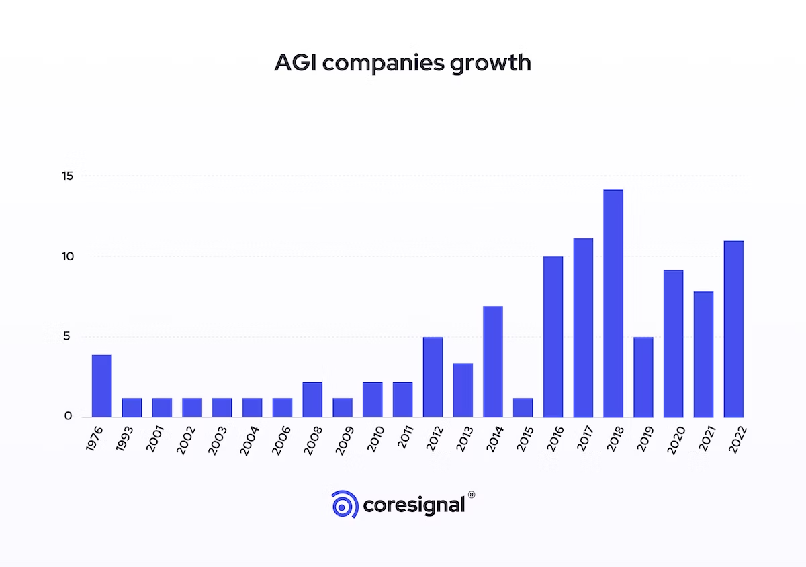

Slide 32
It's important to note that AI-driven predictions are probabilistic and should be used as decision-support tools rather than making critical decisions solely based on them. Additionally, data privacy and security considerations are crucial when working with sensitive information from the Registrar of Companies.

Slide 33
FEATURE EXTRACTION

Slide 34
Time-Based Features: Extract features related to time, such as year, quarter, or month, to capture seasonality and time-based patterns.
Statistical Features: Compute statistical metrics such as mean, median, standard deviation, and percentiles for numerical variables over specific time intervals.
Lag Features: Create lag features to capture historical trends. For example, you can create features that represent the registration count from the previous year or quarter.
Natural Language Processing (NLP) Features: If the RoC data contains textual information, use NLP techniques to extract features such as sentiment analysis or keyword frequencies that may indicate business sentiments or trends.
Principal Component Analysis (PCA): Reduce dimensionality by applying PCA to the dataset if there are many features, helping to identify the most important components for prediction.
Feature Selection: Use techniques like feature selection algorithms to identify the most relevant features for prediction models.
The choice of datasets, data preprocessing steps, and feature extraction techniques should be driven by the specific goals of your AI-driven exploration and prediction project. The quality and relevance of the data and features will significantly impact the accuracy and usefulness of the predictions and insights derived from the analysis.

Slide 35
CODING
# Import necessary libraries
import pandas as pd
import numpy as np
import matplotlib.pyplot as plt
from sklearn.model_selection import train_test_split
from sklearn.linear_model import LinearRegression
from sklearn.metrics import mean_squared_error
# Load your RoC dataset (replace 'your_data.csv' with the actual file path)
data = pd.read_csv('your_data.csv')
# Data Preprocessing
# Perform data cleaning, transformation, and feature extraction here
# Example feature engineering (you should adapt this to your dataset)
data['Year'] = pd.to_datetime(data['Registration Date']).dt.year
plt.show()

Slide 36
# Split data into training and testing sets
X = data[['Year', 'Month']] # Example features, adapt as needed
y = data['Registration Count'] # Example target variable, adapt as needed
X_train, X_test, y_train, y_test = train_test_split(X, y, test_size=0.2, random_state=42)
# Train a simple linear regression model (you can use more complex models)
model = LinearRegression()
model.fit(X_train, y_train)
# Make predictions
y_pred = model.predict(X_test)
# Evaluate the model
mse = mean_squared_error(y_test, y_pred)
print(f"Mean Squared Error: {mse}")
# Visualize the results (you can create more sophisticated visualizations)
plt.scatter(X_test['Year'], y_test, color='blue', label='Actual')
plt.plot(X_test['Year'], y_pred, color='red', label='Predicted')
plt.xlabel('Year')
plt.ylabel('Registration Count')
plt.legend()
plt.show()

Slide 37
CODE RUN
If you do not have library
Install pip library
Code run on python interpreter

Slide 38
Summary
This process transforms our initial dataset into a well-prepared dataset for predictive modeling, and it allows us to explore and engineer features that may improve the accuracy of our predictive models.

Slide 39
Conclusion
Recap the key points discussed throughout the presentation and glimpse into the future possibilities and advancements in the field of AI-driven exploration and prediction of company registration trends.

Slide 40
Thank you

